Slide 1
Protecting Data on Smartphones & Tablets from Memory Attacks
Patrick Colp
Jiawen Zhang James Gleeson Sahil Suneja Eyal de Lara
Himanshu Raj Stefan Saroiu Alec Wolman
University of British Columbia
University of British Columbia
University of Toronto Microsoft Research
University of Toronto
Microsoft Research
Notes:
* = press button for animation

Slide 2
Smartphones and Tablets Are Easily Lost or Stolen
Notes:
Mobile devices are easily:
* Lost
* Or stolen
…and you should be frightened

Slide 3
Lost Data on Mobile Devices is at Risk
Notes:
We store lots of personal data on these devices
Contacts, email, passwords, banking details, and even credit cards

Slide 4
Industry Solution #1: Disk encryption
Disk encryption: Protect data-at-rest Adequate for laptops: Laptops often shutdown/hibernating
Inadequate for smartphones & tablets: These devices are always on
Notes:
The industry solution to this problem is to use disk encryption, which is good for protecting data at rest
However, while it provides adequate protection for laptops, which are often off or hibernating…
…it does not provide adequate protection for smartphones and tablets
These devices are almost always on and accessible at the press of a button

Slide 5
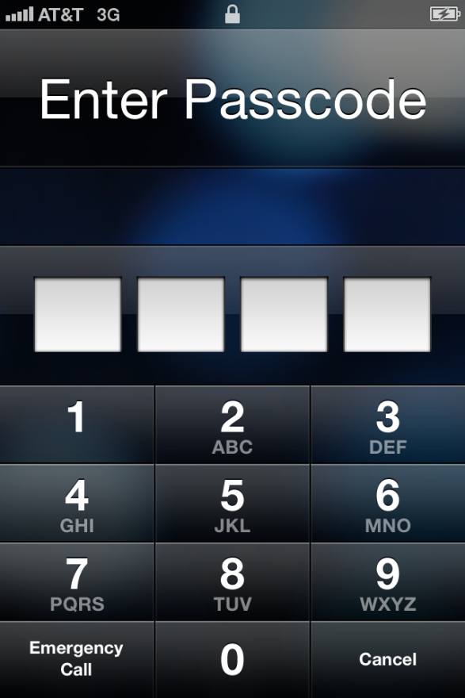
Industry Solution #2: PIN-unlock
Problem: Unencrypted data still resides in RAM!
Notes:
To prevent an unwanted user from accessing mobile devices, a PIN can be used
This technique is good for preventing the attacker from directly accessing sensitive data, simply by using applications
However, a problem remains:
* Unencrypted data still resides in RAM

Slide 6
Imagine an attacker has possession of a stolen device and can’t guess the PIN
What can she do?
Notes:
Imagine that an attacker has possession of a stolen device and can’t guess the PIN?
What can she do?

Slide 7
Memory Attacks
Memory attacks allow attacker to gain access to sensitive data stored in memory
Three classes of memory attacks:
Cold boot attacks
Bus monitoring attacks
DMA attacks
Common aspect of attacks:
Physical possession of the device is required
Notes:
If the attacker can access the contents of memory, sensitive information can be extracted
*
There are three main classes of memory attacks that we consider (and I’ll cover these in more detail later):
Cold boot attacks
Bus monitoring attacks
DMA attacks
*
A common aspect of these attacks is that physical possession of the device is required

Slide 8
Sentry: Store Code & Data On SoC
With Sentry, memory pages are stored:
Encrypted in DRAM
Decrypted on the ARM SoC (System-on-Chip)
encrypt sensitive apps
Device Unlocked
Device PIN-locked
sensitive apps run on-SoC
decrypt-on-demand
Sentry’s Lifecycle
Notes:
Our system, Sentry, addresses this problem by encrypting pages while they are stored in DRAM and decrypting them only on the ARM System-on-Chip (or SoC)
This ensures than an attacker cannot extract sensitive data by looking at the contents of RAM
To improve the performance of our system, we make the observation that encrypting data in RAM on unlocked devices offers no real value (the attacker can just access the data by using applications on the device)
Armed with this observation, we modified the behaviour of Sentry:
When the device is locked, that is, when the device transitions from an unlocked state to a locked state* (top arrow in the diagram), all sensitive memory pages are encrypted
While the device remains in a locked state* (arrow on the right), sensitive applications are run completely off the SoC
Finally, when the device is unlocked, that is, when the device moves from a locked state to an unlocked state*, and continues to run in an unlocked state (arrow on the bottom), memory pages are decrypted on demand

Slide 9
Outline
Introduction
Memory (RAM) attacks
Threat model
Sentry’s system design
Performance evaluation
Related work & conclusions
Notes:
This is the outline of my talk
I’ve talked about the problem we’re trying to solve and introduced our system
*
Next I’ll discuss memory attacks in more detail
*
Then I’ll discuss our threat model
*
After that I’ll discuss the design of Sentry
*
And then we’ll get into the performance evaluation of the system
*
Finally, I’ll touch on some related work and conclude
*
Let’s now look at memory attacks in more detail

Slide 10
Memory Attacks
Three classes of memory attacks:
Cold boot attacks
Bus monitoring attacks
DMA attacks
Notes:
As mentioned earlier, there are three main types of memory attacks
Cold boot attacks
Bus monitoring attacks
And DMA attacks
I’m now going to talk about each in a bit more detail

Slide 11
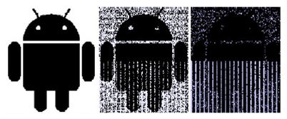
Cold Boot Attacks
DRAM contents don’t instantly disappear after power cut
This is known as the data remanence effect
Cooling memory extends remanence effects
Two types of cold boot attacks
Yank DRAM from device and stick it in a reader
Reflash device with malicious firmware that reads (preserved) contents of DRAM
Recently demonstrated on Android [ACNS’13]
Data remanence effect
Notes:
The premise of all cold boot attacks is that the contents of DRAM doesn’t instantly disappear when power is lost
This is known as the data remanence effect
Below we can see what the data remanence effect looks like on a picture of the Google Android logo stored in memory
Cooling the DRAM chip down extends the data remanence
Can be done by spraying memory with an upside down can of compressed air or putting the device in a freezer
There are two types of cold boot attacks:
The first is to pull the memory chip out of the device and stick it in a reader
Some mobile devices use package-on-package which makes it really hard to remove RAM chips
However, others do not…
The second is to reflash the device with malicious firmware that reads the (preserved) contents of DRAM (e.g., over USB)
Cold boot attacks have been shown for a long time in the PC world
*
However, this type of attack has now been recently demonstrated on Android devices

Slide 12
Modern Tegra3 NVidia Tablet
2 GB of DRAM, room temperature
Three steps:
Write unique bit pattern in device’s DRAM
Mount various cold-boot attacks
Measure fraction of bit pattern still preserved
Type of Attack | DRAM Preserved
OS Reboot (no power loss) | 96.4%
Device Reflash (short power loss) | 97.5%
2 Second Reset (long power loss) | 0.1%
Notes:
We tested the data remanence effect on a Tegra3 tablet with 2 GB of RAM, keeping the RAM at room temperature
First, we wrote a unique bit pattern into memory
Then, we mounted some cold boot attacks
Finally, we measured the fraction of the bit pattern still preserved in RAM
*
The three attacks we tried were:
A normal OS reboot (no power loss). In this case 96.4% of the bit pattern was preserved
When the OS reboots, it overwrites parts of memory. That’s where the 3.6% loss comes from
A device reflash (which resulted in a short power loss). 97.5% of the pattern was preserved
Again, some of this is loss due to writes
Finally, we did a long (2 second) reset with power loss. Only 0.1% of the pattern remained in this case – remember, these experiments were done at room temperature. If cold, more would be preserved

Slide 13
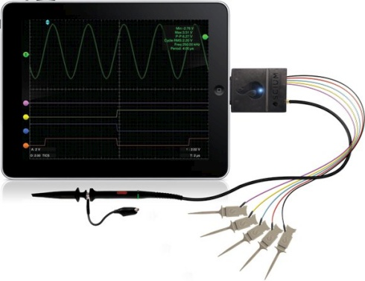
Bus Monitoring Attacks
Place monitoring device on memory bus to record communication
Cannot directly access memory contents, but can copy all data travelling in-and-out of memory
Notes:
The next type of memory attack is the bus monitoring attack
A bus monitor attacks involves attaching a device to the memory bus and observing the data that is transferred across it
While with this approach the contents of memory cannot be directly accessed, over time enough data can be extracted
The key itself
Or access to other structures that could leak information about the key
People have been able to turn iPads into bus monitoring devices, as demonstrated in the picture

Slide 14
DMA Attacks
Attach malicious DMA-based peripheral to stolen tablet
Dump entire DRAM
Today less prevalent because most smartphones and tablets lack DMA ports
This could change with adoption of Thunderbolt
Notes:
Finally, we consider DMA attacks
A DMA attack involves attaching a malicious DMA device which manipulates the DMA controller in order to read arbitrary memory
Currently this type of attack is less prevalent as DMA ports are rare on mobile devices
However, with the adoption of Thunderbolt, this could change

Slide 15
Outline
Introduction
Memory (RAM) attacks
Threat model
High-level system design
Performance evaluation
Related work & conclusions
Notes:
Now that we understand the types of memory attacks available…
*
…I’ll briefly discuss our threat model

Slide 16
Threat Model
In-scope:
Cold boot, bus monitoring, DMA attacks
Out-of-scope:
Software attacks/malware
Physical side-channel attacks
Code-injection attacks
JTAG attacks
Sophisticated physical attacks
Notes:
Since mobile devices are easily lost or stolen, we focus on relatively unsophisticated attacks
(Cold boot, bus monitoring, and DMA attacks)
These are attacks that “anybody” can perform
We are not concerned with other types attacks:
Software attacks (/malware)
This class of attack compromise the software on a mobile device and can thus access and steal any secrets, including the PIN unlock code
In our case, since we’re worried about somebody having physical access to the device, this is prevented by using a PIN code
Physical side-channel attacks
Side-channel attacks try to obtain sensitive information by exploiting physical properties of cryptographic implementations, such as timing information or power consumption
Code-injection attacks
This class of attack inject or modify code running on the platform
One way to mount this attack is to use a compromised DMA-capable device
JTAG attacks
JTAG is a hardware debugging interface
Port on the motherboard to debug the state of the hardware
On some devices, this can be a huge issue
However, we know how to fix it (just disable JTAG)
Or more sophisticated physical attacks
It is hard to anticipate all types of physical attacks
One example of an advanced attack is using an electron microscope to examine the internals of the ARM SoC chip and carry attacks on the stored data
Although possible, such an attack requires specialized equipment and can often take several months even when carried out by a skilled attacker

Slide 17
Outline
Introduction
Memory (RAM) attacks
Threat model
Sentry’s system design
Performance evaluation
Related work & conclusions
Notes:
Now that we understand the threat model…
*
…I’ll discuss the design of our system

Slide 18
Sentry in Action: Upon Device Lock
Encrypted pages
Unencrypted pages
Sensitive app
SoC
DRAM
Limited On-SoC Memory
Page Table
Notes:
First we’ll look at Sentry in action when the device gets locked (transitions from unlocked to locked state)
Here, we have a sensitive application (with a sensitive memory page) at the top
We also have some non-sensitive data
When the device is locked, what happens is that the pages of sensitive applications are encrypted
*
As we can see, the page for the sensitive application is now encrypted
Notice that the pages for regular applications stay unencrypted
It’s only the page(s) for the sensitive applications that are encrypted

Slide 19
Sentry in Action: Sensitive Apps Running in Background (Locked Device)
Encrypted pages
Unencrypted pages
Sensitive app
SoC
DRAM
Limited On-SoC Memory
Page Table
Notes:
Next we’ll look at Sentry in action while the device remains locked and sensitive applications run in the background
When an encrypted page is accessed * it is copied into on-SoC memory
There it is decrypted in place * (in the on-SoC memory)
Finally, the page table entry is update to point to the new page *
When on-SoC memory becomes full, a page will need to be evicted back out to DRAM
This is the reverse process of what we just saw
First, the page is encrypted in place * (in on-SoC memory)
Then, it is copied back out to its original location in RAM *
Finally, the page table entry is updated to point back to the original location *
This process allows us to transparently run applications while keeping their DRAM contents encrypted at all times

Slide 20
Sentry in Action: Upon Device Unlock
Encrypted pages
Unencrypted pages
Sensitive app
SoC
DRAM
Limited On-SoC Memory
Page Table
Notes:
Finally, we’ll look at Sentry in action when the device is unlocked
That is, when it transitions from a locked state to an unlocked state and continues to run in an unlocked state
In this case, when a page is accessed, it is simply decrypted on-demand *

Slide 21
Sentry’s Challenges
Where on SoC can code and data be kept?
How can crypto be done in-place on the SoC?
How do we guarantee no data “leaks” to DRAM?
How do we secure freed memory pages?
How do we bootstrap?
What are minimum on SoC requirements?
Notes:
In order for all this to work, there are several challenges that Sentry must overcome
1. Where on SoC can code and data be kept?
What storage options do we have available on the SoC?
2. How can crypto be done in-place on the SoC?
What special considerations do we have to make to ensure that no secret state escapes the SoC?
3. How do we guarantee no data “leaks” to DRAM?
How do we make sure there is no bug in Sentry that exposes sensitive data accidentally?
4. How do we secure freed memory pages?
How do we ensure no data leaked in freed pages (e.g., they aren’t cleared properly)?
5. How do we bootstrap?
Where do the encryption keys come from?
6. What are minimum on SoC requirements?
What’s the minimum requirement on on-SoC storage

Slide 22
Sentry’s Challenges
Where on SoC can code and data be kept?
How can crypto be done in-place on the SoC?
How do we guarantee no data “leaks” to DRAM?
How do we secure freed memory page?
How do we bootstrap?
What are minimum on SoC requirements?
Notes:
For this talk, I’m just going to concentrate on the first two:
Where on the SoC can the code and data be kept?
How can crypto be done in-place on the SoC?
Please read the paper for answers to the rest of the questions

Slide 23
On-SoC Storage
Internal RAM (iRAM)
Some devices ship with small iRAM (e.g., 256 KB)
Locked L2 cache
ARM cache controllers offer cache locking
Aimed at embedded systems for performance predictability
Safe against cold-boot attacks
Unflashable firmware erases iRAM
Safe against bus monitoring attacks
Safe against DMA attacks
iRAM is DMA-able; need TrustZone-based DMA protections
Notes:
First we’ll look at the on-SoC storage options available to us
In modern devices, there are two main sources of this on-SoC storage:
First, internal RAM (iRAM) is a small amount (e.g., 256KB) of RAM (typically static RAM)
Provided for use by firmware and devices
Second, the ARM platform offers a way to lock parts of the L2 cache
Any data locked in the cache is prevented from being evicted out to main memory
Originally designed for performance reasons (for deterministic access times, useful in things like real-time systems)
*
Both of these options are:
Safe against cold-boot attacks
Unflashable firmware erases iRAM at power-up
Safe against bus monitoring attacks
Everything is on-SoC, so there’s no bus exposed to monitor
And safe against DMA attacks
iRAM is DMA-able, but it’s possible to use ARM TrustZone to protect DMA

Slide 24
In-place (on SoC) Crypto
Can’t encrypt kernel stack
Too much of a performance hit
AES_on_SoC: in-place AES for ARM
Notes:
The second challenge I’m going to discuss is how to perform encryption in-place on the SoC
We are using an in-kernel version of AES, so an issue we have to deal with is the kernel stack
*
Unfortunately we can’t just encrypt the kernel stack
This would require potentially encrypting other parts of the kernel
And in either case would take too much of a performance hit
*
Instead we implemented AES_on_SoC, which does AES in-place on the SoC
Having an on-SoC version of AES is important because…
…in order to protect sensitive data, we need a way to encrypt the data…
…but we need to ensure that no encryption state is leaked to memory
Otherwise there’s no point
If the AES key can be extracted, all of the sensitive data – all of the encrypted data – is vulnerable

Slide 25
Two Issues
Context switching AES places sensitive state in DRAM (on stack)
Solution: disable interrupts on encrypt/decrypt
Stack variables (e.g., arguments to function calls)
Solution: Rewrite AES code to ensure all sensitive state resides in registers only
Notes:
In order to implement AES_on_SoC, we have to deal with two major issues:
*
The first issue is context switching
On context switch, the CPU state is written out – in this case – to the kernel stack, which places sensitive AES state in DRAM
To deal with this, what we do is disable interrupts while performing encryption and decryption
This ensures that all state stays on SoC
*
The second issue to deal with is stack variables
This could be variables created within functions or arguments to function calls
For example, ARM specifies that only the first four arguments to a function are passed in registers, all other arguments are passed on the stack
What we did is we rewrote the AES code (at the assembly language level) to ensure that all sensitive state only ever resides in registers

Slide 26
Outline
Introduction
Memory (RAM) attacks
Threat model
Sentry’s system design
Performance evaluation
Related work & conclusions
Notes:
Now that we know how Sentry works…
*
…what we want to know is “how well does it perform?”

Slide 27
Methodology
Two Sentry prototypes:
NVidia Tegra3 tablet running Ubuntu Linux
Quad-core Cortex A9 running at 1.2GHz + 1GB of RAM
Google Nexus 4 smartphone running Android
Quad-core SnapdragonS4 running at 1.5GHz + 2GB of RAM
Apps: Contacts, Google Maps, Twitter, MP3
All experiments:
Repeated 10 times
Performed L2 cache locking on NVidia only
Measured energy performance on Nexus only
Notes:
We implemented two Sentry prototypes:
One on an nVidia Tegra3 tablet
And one on a Google Nexus 4 smartphone
We ran our experiments on Contacts, Google Maps, Twitter, and an MP3 app…
…and we repeated each experiment 10 times
Cache locking was only done on the nVidia tablet
Energy performance was only measured on the Nexus 4

Slide 28
Performance & Energy Questions
What is Sentry’s overhead?
Upon locking and unlocking a device
While decrypting on-demand on running apps
When running sensitive app in background
For protecting OS subsystem (dm-crypt)
What is Sentry’s impact to the rest of system?
Portion of L2 cache allocated to Sentry
Notes:
We wanted to answer two broad categories of questions
What is Sentry’s overhead
And what is the impact of Sentry on the rest of the system?

Slide 29
Performance & Energy Questions
What is Sentry’s overhead?
Upon locking and unlocking a device
While decrypting on-demand on running apps
When running sensitive app in background
For protecting OS subsystem (dm-crypt)
What is Sentry’s impact to the rest of system?
Portion of L2 cache allocated to Sentry
Notes:
For brevity, in this talk I’ll only discuss performance overhead (and not energy)
I’m just going to focus on the overhead of lock/unlock operations and while decrypting on-demand on running apps
For the rest of the results, please read our paper

Slide 30
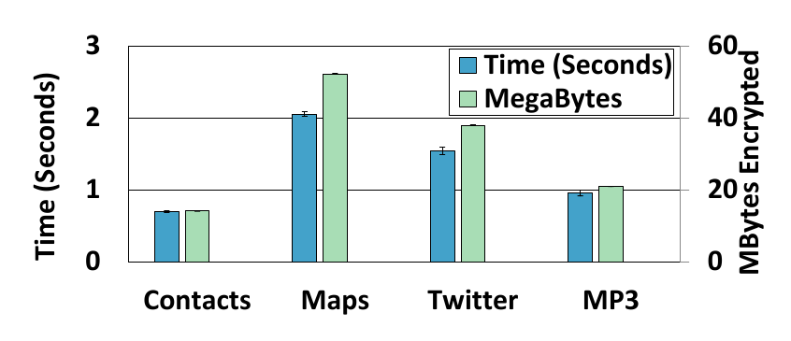
Performance Overhead on Lock
0.7-2.1 seconds overhead per application
Notes:
The first graph shows the performance overhead of when the device gets locked
The left axis and left bar for each app shows the additional time taken for each app on lock
The right axis and right bar for each app shows the amount of memory in megabytes encrypted
There is a rough correlation between the amount of data encrypted and the time taken
*
There is 0.7 to 2.1 seconds of overhead per application

Slide 31
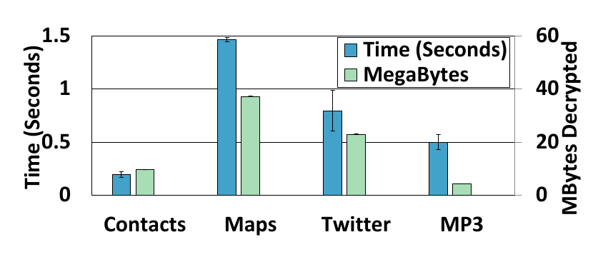
Performance Overhead on Unlock
Minimum state required for apps to operate
0.2-1.5 seconds overhead per application
Notes:
Next, we look at the performance overhead of when the device gets unlocked
Like the last graph, left axis and left bars are additional time taken and right axis bar and right bars are the amount of memory in megabytes
This time it’s showing the amount of memory decrypted, though
This represents the minimum amount of data that needs to be decrypted in order to get the apps to a point where the user can interact with it
The rest is done on-demand
We can see a rough correlation between the time taken and the amount of data decrypted
*
There is 0.2 to 1.5 seconds of overhead per application

Slide 32
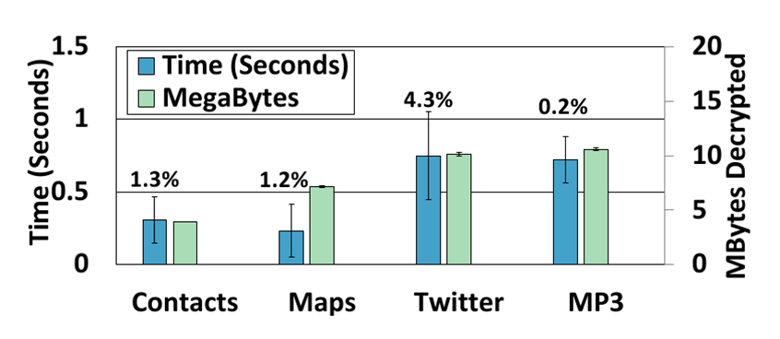
Overhead of Decrypt On-Demand
Less than 5% performance overhead per application
Notes:
Finally, we look at the overhead of doing decrypt on-demand on running applications
Again, left is time, right is megabytes decrypted
For this experiment, we scripted each app to perform a series of typical tasks upon device unlock
This graph shows the *additional* time that Sentry imposes on these scripts
We also show the percentage of the total that these times represent
For example, the Contacts app script took 23 seconds to run, Sentry adds an addition 0.3 seconds
This represents a 1.3% runtime overhead
*
There is less than 5% performance overhead for each application
(Contacts took 23 seconds
Maps took 20 seconds
Twitter script took 17 seconds
MP3 app took 5 minutes)

Slide 33
Outline
Introduction
Memory (RAM) attacks
Threat model
Sentry’s system design
Performance evaluation
Related work & conclusions
Notes:
- Finally, * I’ll touch on some related work and conclude

Slide 34
Related Work
On-chip AES schemes for x86:
AESSE [Eurosec’10]
TRESOR [Sec’11]
Encrypted RAM
Cryptkeeper [ICTHS’10]
Encrypt-on-cache-evict [DATE’08]
Cloud-backed encrypt-on-lock
ZIA [Mobicom’02]
Transient Authentication [Mobisys’03]
Clean OS [OSDI’12]
Notes:
There has been some related work in this general area:
Some systems have been designed to provide secure, on-chip AES for x86
Uses SSE registers or performance counters
These approaches have very little protected storage
Only enough to store encryption key
As a result, they can’t protect against bus monitoring attacks
Other systems to provided encrypted RAM
Cryptkeeper encrypts all (most) of RAM all the time
Suffers from terrible performance
Encrypt-on-cache-evict was just a proof-of-concept
Never actually built the system
Finally some have proposed cloud-backed encrypt-on-lock systems
ZIA protects encrypted file systems by only decrypting files if a special device is present
Such as a smartwatch with bluetooth
However, this only protects data at rest, not data in RAM
Transient Authentication extends ZIA to protect running applications
However, encrypted applications are suspended and cannot be run in the background
Clean OS evicts encryption keys to the cloud
When the sensitive data is in use, the key exists in memory, and is therefore vulnerable to memory attacks

Slide 35
Conclusions
Smartphones/tablets are vulnerable to memory attacks
Sentry protects these devices by keeping sensitive data encrypted in DRAM
ARM is amenable to on-SoC storage of sensitive apps’ data & code
Notes:
Summing up, smartphones and tablets are vulnerable to memory attacks
Our system, Sentry, protects these devices by keeping sensitive data encrypted in DRAM
And does so with low performance (and energy) overhead
The ARM platform is amenable – today – to the use of on SoC storage for the data and code of sensitive applications

Slide 36
Questions?
pjcolp@cs.ubc.ca
Notes:
Thank you

Slide 38
Two Treat Models
Our model:
Attacker has possession of device
Not our model:
Malicious OS or software running on the device

