Slide 1
Intelligent Systems (AI-2)
Computer Science cpsc422, Lecture 27
Nov, 13, 2019
Notes:
Lecture 28

Slide 2
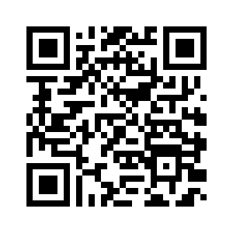
Call For Participants
Explainable AI in Intelligent Tutoring Systems
3h | $30 | ICICS/CS Building
Email obarral@cs.ubc.ca
If you have any questions
Doodle Sign-up

Slide 3
Lecture Overview
Recap Probabilistic Context Free Grammars (PCFG)
CKY parsing for PCFG (only key steps)
PCFG in practice: Modeling Structural and Lexical Dependencies

Slide 4
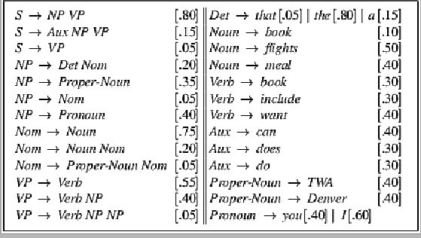
Sample PCFG

Slide 5
PCFGs are used to….
Estimate Prob. of parse tree
Estimate Prob. to sentences
Notes:
The probability of a derivation (tree) is just the product of the probabilities of the rules in the derivation.
Product because rule applications are independent (because CFG)
integrate them with n-grams
The probability of a word sequence (sentence) is the probability of its tree in the unambiguous case.
It’s the sum of the probabilities of the trees in the ambiguous case.

Slide 6
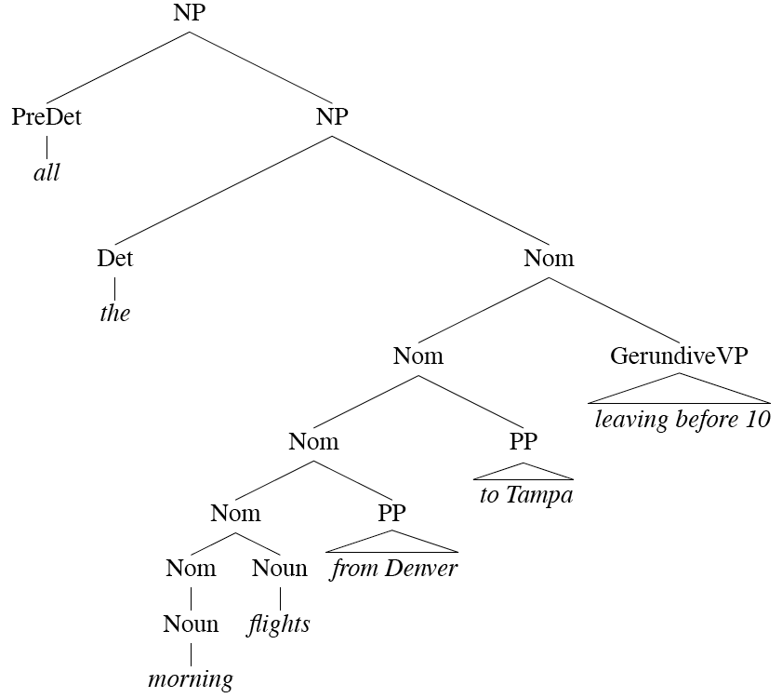
Head of a Phrase
Notes:
For each phrase type Simple set of hand-written rules to find the head of such a phrase.
This rules are often called head percolation

Slide 7
Acquiring Grammars and Probabilities
Manually parsed text corpora (e.g., PennTreebank)
Grammar: read it off the parse trees
Ex: if an NP contains an ART, ADJ, and NOUN then we create the rule NP -> ART ADJ NOUN.
Probabilities:
Notes:
We can create a PCFG automatically by exploiting manually parsed text corpora, such as the Penn Treebank. We can read off them grammar found in the treebank.
Probabilities: can be assigned by counting how often each item is found in the treebank
Ex: if the NP -> ART ADJ NOUN rule is used 50 times and all NP rules are used 5000 times, then the rule’s probability is 50/5000 = .01

Slide 8
Lecture Overview
Recap Probabilistic Context Free Grammars (PCFG)
CKY parsing for PCFG (only key steps)
PCFG in practice: Modeling Structural and Lexical Dependencies

Slide 9
Probabilistic Parsing:
  (Restricted) Task is to find the max probability tree for an input
Notes:
We will look at a solution to a restricted version of the general problem of finding all
possible parses of a sentence and their corresponding probabilities

Slide 10
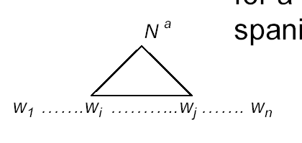
Probabilistic CKY Algorithm
Ney, 1991 Collins, 1999
CYK (Cocke-Kasami-Younger) algorithm
  A bottom-up parser using dynamic programming
  Assume the PCFG is in Chomsky normal form (CNF)
Definitions
  w₁… w_{n} an input string composed of n words
  w_{ij} a string of words from word i to word j
  µ[i, j, A] : a table entry holds the maximum probability for a constituent with non-terminal A spanning words w_{i}…w_{j}
A
Notes:
First described by Ney, but the version we are seeing here is adapted from Collins

Slide 11
Probabilistic CKY Algorithm
Definitions
  w₁… w_{n} an input string composed of n words
  w_{ij} a string of words from word i to word j
  µ[i, j, A] : a table entry holds the maximum probability for a constituent with non-terminal A spanning words w_{i}…w_{j}
A
Notes:
First described by Ney, but the version we are seeing here is adapted from Collins

Slide 12
Probabilistic CKY Algorithm
Definitions
  w₁… w_{n} an input string composed of n words
  w_{ij} a string of words from word i to word j
  µ[i, j, A] : a table entry holds the maximum probability for a constituent with non-terminal A spanning words w_{i}…w_{j}
A
Notes:
First described by Ney, but the version we are seeing here is adapted from Collins

Slide 13
CKY: Base Case
Fill out the table entries by induction: Base case
  Consider the input strings of length one (i.e., each individual word w_{i})
  Since the grammar is in CNF: A *⇒ w_{i} iff A → w_{i}
  So µ[i, i, A] = P(A → w_{i})
“Can₁ you₂ book₃ TWA₄ flights₅ ?”
Aux
Noun
1
.4
……
.5
5
1
5

Slide 14


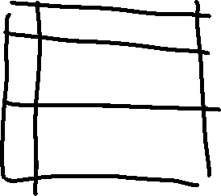

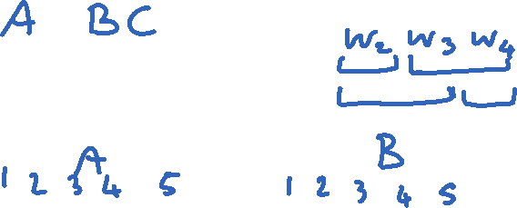
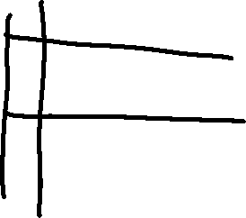

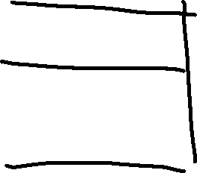
Probabilistic CKY Algorithm: recursive case (visual)

Slide 15
CKY: Recursive Case
Recursive case
  For strings of words of length = 2,
  A *⇒ w_{ij} iff there is at least one rule A → BC
  where B derives the first k words (between i and i+k-1 ) and C derives the remaining ones (between i+k and j)
A
  µ[i, j, A] = µ [i, i+k-1, B] *
  µ [i+k, j, C ] *
  P(A → BC)
B
C
i
i+k-1
i+k
j
  (for each non-terminal) Choose the max among all possibilities
Notes:
Compute the probability by multiplying together the probabilities of these two pieces (note that they have been calculated in the recursion)
2<= k <= j – i - 1

Slide 16
CKY: Termination
  The max prob parse will be µ [ ]
“Can₁ you₂ book₃ TWA₄ flight₅ ?”
5
S
1
1.7x10⁻⁶
5
Notes:
Any other filler for this matrix?
1,3 and 1,4 and 3,5 !

Slide 17

CKY: Termination
  Any other entry in this matrix for S?
A. Yes
C. Cannot Tell
B. No
“Can₁ you₂ book₃ TWA₄ flight₅ ?”
5
S
1
1.7x10⁻⁶
1,3 and 1,4 and 3,5 …. !
5
Notes:
Any other filler for this matrix?
1,3 and 1,4 and 3,5 !

Slide 18
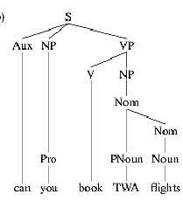
CKY: anything missing?
  The max prob parse will be µ [ ]
“Can₁ you₂ book₃ TWA₄ flight₅ ?”
5
S
1
1.7x10⁻⁶
5

Slide 19
Lecture Overview
Recap Probabilistic Context Free Grammars (PCFG)
CKY parsing for PCFG (only key steps)
PCFG in practice: Modeling Structural and Lexical Dependencies

Slide 20
Problems with PCFGs
Most current PCFG models are not vanilla PCFGs
  Usually augmented in some way
Vanilla PCFGs assume independence of non-terminal expansions
But statistical analysis shows this is not a valid assumption
  Structural and lexical dependencies
Notes:
Probabilities for NP expansions do not depend on context.

Slide 21
Structural Dependencies: Problem
E.g. Syntactic subject (vs. object) of a sentence tends to be a pronoun because
  Subject tends to realize the topic of a sentence
  Topic is usually old information (expressed in previous sentences)
  Pronouns are usually used to refer to old information
  Mary bought a new book for her trip. She didn’t like the first chapter. So she decided to watch a movie.
  In Switchboard corpus:
Notes:
I do not get good estimates for the pro
Parent annotation technique
91% of subjects in declarative sentences are pronouns
66% of direct objects are lexical (nonpronominal)
(i.e., only 34% are pronouns)
Subject tends to realize the topic of a sentence
Topic is usually old information
Pronouns are usually used to refer to old information
So subject tends to be a pronoun

Slide 22
How would you address this problem?

Slide 23
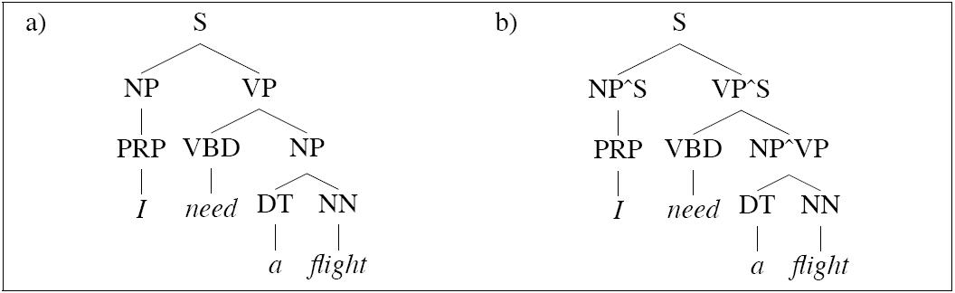
Structural Dependencies: Solution
Split non-terminal. E.g., NPsubject and NPobject
Parent Annotation:
Hand-write rules for more complex struct. dependencies
Splitting problems?
  Automatic/Optimal split – Split and Merge algorithm [Petrov et al. 2006- COLING/ACL]
Notes:
I do not get good estimates for the pro
Parent annotation technique
Splitting problems
- Increase size of the grammar -> reduces amount of training data for each rule -> leads to overfitting

Slide 24
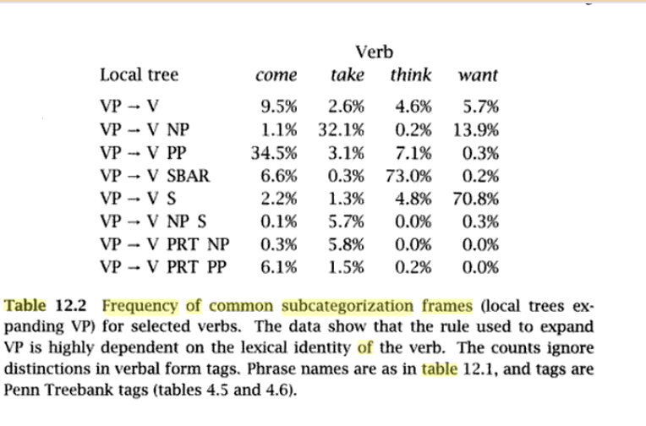
Lexical Dependencies: Problem
SBAR = subordinate clause
Notes:
The verb send subcategorises for a destination, which could be a PP headed by “into”
SBAR stands for Subordinate Clause

Slide 25
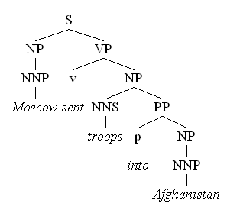
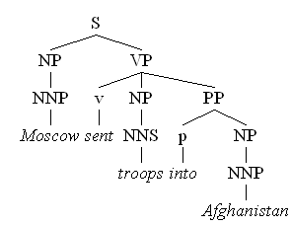
Lexical Dependencies: Problem
Two parse trees for the sentence
“Moscow sent troops into Afghanistan”
(a)
(b)
VP-attachment
NP-attachment
Typically NP-attachment more frequent than VP-attachment
Notes:
The verb send subcategorises for a destination, which could be a PP headed by “into”

Slide 26
Attribute grammar for Lexicalized PCFG : each non-terminal is annotated with its lexical head… many more rules!
(Collins 1999)
We used to have rules like
  VP -> V NP PP
Now we have much more specific rules like
  VP(dumped)-> V(dumped) NP(sacks) PP(into)
Notes:
Each non-terminal is annotated with a single word which is its lexical head
A CFG with a lot more rules!
We used to have rule r
VP -> V NP PP P(r|VP)
That’s the count of this rule divided by the number of VPs in a treebank

Slide 27
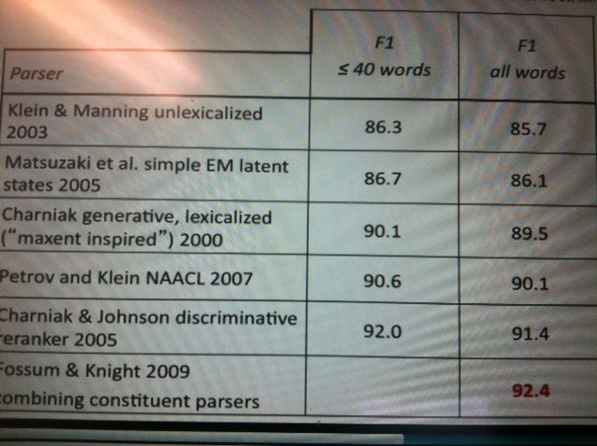
PCFG Parsing State of the art(~2010)
  From C. Manning (Stanford NLP)
Notes:
Most effective: Combining lexicalized and unlexicalized

Slide 28
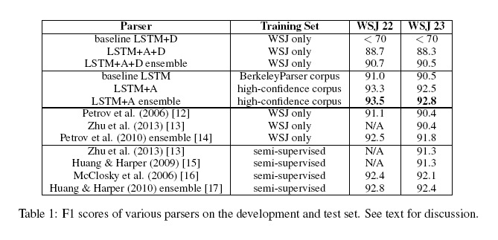
Grammar as a Foreign Language
Computation and Language [cs.CL] Published 24 Dec 2014
Updated 9 Jun 2015
O. Vinyals, L. Kaiser, T. Koo, S. Petrov, I. Sutskever, G. Hinton Google
Fast and Accurate Shift-Reduce Constituent Parsing by Muhua Zhu, Yue Zhang, Wenliang Chen, Min Zhang and Jingbo Zhu (ACL - 2013)

Slide 29
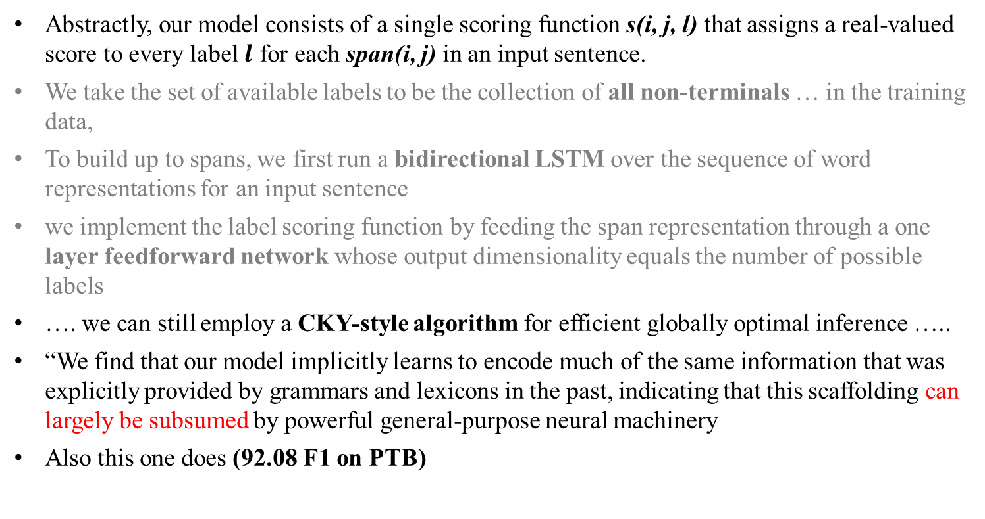
Very recent paper (NAACL 2018)
What’s Going On in Neural Constituency Parsers? An Analysis,
D.Gaddy, M. Stern, D. Klein, Computer Science ., Univ. of California, Berkeley
Abstractly, our model consists of a single scoring function s(i, j, l) that assigns a real-valued score to every label $l$ for each span(i, j) in an input sentence.
We take the set of available labels to be the collection of all non-terminals … in the training data,
To build up to spans, we first run a bidirectional LSTM over the sequence of word representations for an input sentence
we implement the label scoring function by feeding the span representation through a one layer feedforward network whose output dimensionality equals the number of possible labels
…. we can still employ a CKY-style algorithm for efficient globally optimal inference …..
“We find that our model implicitly learns to encode much of the same information that was explicitly provided by grammars and lexicons in the past, indicating that this scaffolding can largely be subsumed by powerful general-purpose neural machinery
Also this one does (92.08 F1 on PTB)
Notes:
A number of differences have emerged between modern and classic approaches to constituency parsing in recent years, with structural
components like grammars and feature rich lexicons becoming less central while recurrent neural network representations rise in
popularity. The goal of this work is to analyze the extent to which information provided directly by the model structure in classical systems
is still being captured by neural methods. To this end, we propose a high-performance neural model (92.08 F1 on PTB) that is representative
of recent work and perform a series of investigative experiments. We find that our model implicitly learns to encode much of
the same information that was explicitly provided by grammars and lexicons in the past, indicating that this scaffolding can largely be
subsumed by powerful general-purpose neural machinery.
“Abstractly, our model consists of a single scoring function s(i, j, l) that assigns a real-valued score to every label $l$ for each span(i, j) in an input sentence.
We take the set of available labels to be the collection of all non-terminals and unary chains observed in the training data,
To build up to spans, we first run a bidirectional LSTM over the sequence of word representations for an input sentence
we implement the label scoring function by feeding the span representation through a one layer feedforward network whose output dimensionality equals the number of possible labels
…. Even though our model operates on n-ary trees, we can still employ a CKY-style algorithm for efficient globally optimal inference by introducing an auxiliary empty label
“We find that our model implicitly learns to encode much of the same information that was explicitly provided by grammars and lexicons in the past, indicating that this scaffolding can largely be subsumed by powerful general-purpose neural machinery”

Slide 30
Beyond NLP……. Planning…..
CKY/PCFG Beyond syntax……. Discourse Parsing….. And Dialog
CKY Probabilistic parsing Paper in Reading
Conversation Trees: A Grammar Model for Topic Structure in Forums, Annie Louis and Shay B. Cohen, EMNLP 2015. [corpus]
Li, N., Cushing, W., Kambhampati, S., & Yoon, S. (2012). Learning probabilistic hierarchical task networks as probabilistic context-free grammars to capture user preferences. ACM Transactions on Intelligent Systems and Technology. (CMU+Arizona State)
Notes:
Probabilistic Context-Free Grammars (PCFG) and Probabilistic Linear Context-Free Rewriting Systems (PLCFRS). In the PCFG model, a non-terminal spans a contiguous sequence of posts. In the PLCFRS model, non-terminals are allowed to span discontinuous segments of posts.

Slide 31
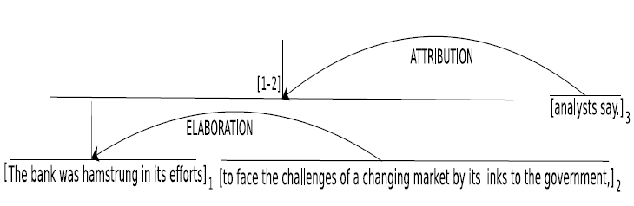
Discovering Discourse Structure: Computational Tasks
The bank was hamstrung in its efforts to face the challenges of a changing market by its links to the government, analysts say.
Discourse Segmentation
The bank was hamstrung in its efforts
to face the challenges of a changing
market by its links to the government,
analysts say.
1
2
3
Discourse Parsing
Notes:
Discourse analysis in RST involves two subtasks. 1. breaking the text into EDUs, known as discourse segmentation, 2. linking the EDUs into a labeled hierarchical tree structure, known as discourse parsing.

Slide 32
StarAI (statistical relational AI)
Hybrid: Det +Sto
422 big picture
Prob CFG
Prob Relational Models
Markov Logics
Deterministic
Stochastic
Belief Nets
Logics
Approx. : Gibbs
First Order Logics
Markov Chains and HMMs
Ontologies
Forward, Viterbi….
Approx. : Particle Filtering
Query
Full Resolution
SAT
Undirected Graphical Models
Markov Networks
Conditional Random Fields
Markov Decision Processes and
Partially Observable MDP
Planning
Value Iteration
Approx. Inference
Reinforcement Learning
Representation
Applications of AI
Reasoning
Technique
Notes:
Breadth and Depth

Slide 33
Learning Goals for today’s class
You can:
Describe the key steps of CKY probabilistic parsing
Motivate introduction of structural and lexical dependencies
Describe how to deal with these dependencies within the PCFG framework

Slide 34
Next class on Fri : paper discussion
Portions of our Journal of Computational Linguistics paper only sections 1, 3 and 4 are mandatory
CODRA: A Novel Discriminative Framework for Rhetorical Analysis
Assignment-3 due on Mon
Assignment-4 will be out on the same day

Slide 35
More specific rules
We used to have rule r
  VP -> V NP PP P(r|VP)
    That’s the count of this rule divided by the number of VPs in a treebank
Now we have rule r
  VP(h(VP))-> V(h(VP)) NP PP P(r | VP, h(VP))
  VP(sent)-> V(sent) NP PP P(r | VP, sent)
  What is the estimate for P(r | VP, sent) ?
  How many times was this rule used with sent, divided by the number of VPs that sent appears in total
Notes:
Also associate the head tag e.g.,
NP(sacks,NNS) where NNS is noun, plural

Slide 36
NLP Practical Goal for FOL (and Prob. Parsing) the ultimate Web question-answering system?
  Map NL queries into FOPC so that answers can be effectively computed
What African countries are not on the Mediterranean Sea?
Was 2007 the first El Nino year after 2001?
Notes:
We didn’t assume much about the meaning of words when we talked about sentence meanings
Verbs provided a template-like predicate argument structure
Nouns were practically meaningless constants
There has be more to it than that
View assuming that words by themselves do not refer to the world, cannot be
Judged to be true or false…

Slide 37
Grammar as a Foreign Language
Computation and Language [cs.CL] Published 24 Dec 2014
Updated 9 Jun 2015
Oriol Vinyals, Lukasz Kaiser, Terry Koo, Slav Petrov, Ilya Sutskever, Geoffrey Hinton Google
Fast and Accurate Shift-Reduce Constituent Parsing by Muhua Zhu, Yue Zhang, Wenliang Chen, Min Zhang and Jingbo Zhu (ACL - 2013)
Announcing SyntaxNet: The World’s Most Accurate Parser Goes Open Source, 2016; Posted by Slav Petrov, Senior Staff Research Scientist (different parsing framework)
Notes:
+ A attention mechanism

Slide 38
Structural Dependencies: Problem
E.g. Syntactic subject of a sentence tends to be a pronoun
  Subject tends to realize “old information”
  “Mary bought a new book for her trip. She didn’t like the first chapter. So she decided to watch a movie.”
  In Switchboard corpus:
Notes:
I do not get good estimates for the pro
Parent annotation technique
91% of subjects in declarative sentences are pronouns
66% of direct objects are lexical (nonpronominal)
(i.e., only 34% are pronouns)
Subject tends to realize the topic of a sentence
Topic is usually old information
Pronouns are usually used to refer to old information
So subject tends to be a pronoun

Slide 39
How would you address this problem?

Slide 40
Structural Dependencies: Solution
Split non-terminal. E.g., NPsubject and NPobject
Parent Annotation:
Hand-write rules for more complex struct. dependencies
Splitting problems?
  Automatic/Optimal split – Split and Merge algorithm [Petrov et al. 2006- COLING/ACL]
Notes:
I do not get good estimates for the pro
Parent annotation technique
Splitting problems
- Increase size of the grammar -> reduces amount of training data for each rule -> leads to overfitting

Slide 41
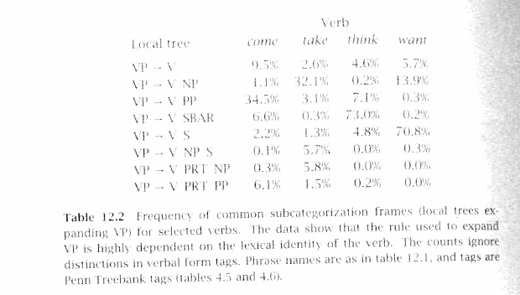
Lexical Dependencies: Problem
(b)
Notes:
The verb send subcategorises for a destination, which could be a PP headed by “into”

Slide 42
Lexical Dependencies: Problem
Two parse trees for the sentence
“Moscow sent troops into Afghanistan”
(b)
(a)
VP-attachment
NP-attachment
Typically NP-attachment more frequent than VP-attachment
Notes:
The verb send subcategorises for a destination, which could be a PP headed by “into”

Slide 43
Lexical Dependencies: Solution
Add lexical dependencies to the scheme…
  Infiltrate the influence of particular words into the probabilities of the rules
  All the words?
(a)
  P(VP -> V NP PP | VP = “sent troops into Afg.”)
  P(VP -> V NP | VP = “sent troops into Afg.”)
(b)
A. Good Idea
B. Bad Idea
C. Cannot Tell
Notes:
No only the key ones

Slide 44
Lexical Dependencies: Solution
Add lexical dependencies to the scheme…
  Infiltrate the influence of particular words into the probabilities of the rules
  All the words?
(a)
  P(VP -> V NP PP | VP = “sent troops into Afg.”)
  P(VP -> V NP | VP = “sent troops into Afg.”)
(b)
Not likely to have significant counts in any treebank!
A. Good Idea
B. Bad Idea
C. Cannot Tell
Notes:
No only the key ones

Slide 45
Use only the Heads
To do that we’re going to make use of the notion of the head of a phrase
  The head of an NP is its noun
  The head of a VP is its verb
  The head of a PP is its preposition
Notes:
(but for other phrases can be more complicated and somewhat controversial)
Should the complementizer TO or the verb be the head of an infinite VP?
Most linguistic theories of syntax of syntax generally include a component that defines heads.

